Slide 1
The 2020 pandemic in comparative historical perspective an illustrated reflection by the UIUC Department of Anthropology

Slide 2
March 10, 2020
This action – to quarantine an epicenter of the
emerging pandemic – seemed extraordinary at
the moment. Yet late in the summer of 1665 the
church rector of Eyam, a small village in the
East Midlands of England exhorted his flock
to self-quarantine in the face of a deadly
plague they could not understand – as we do
the Covid-19 virus today.
In an act of extraordinary civic responsibility
and moral underpinning, the villagers of Eyam
agreed to heed their rector, knowing full well
that many – perhaps most – would die. The
plague took a terrible toll in all families, some
of which were completely lost over the course
of a terrible year. LEARN MORE→
New
Rochelle
Manhattan

Slide 3
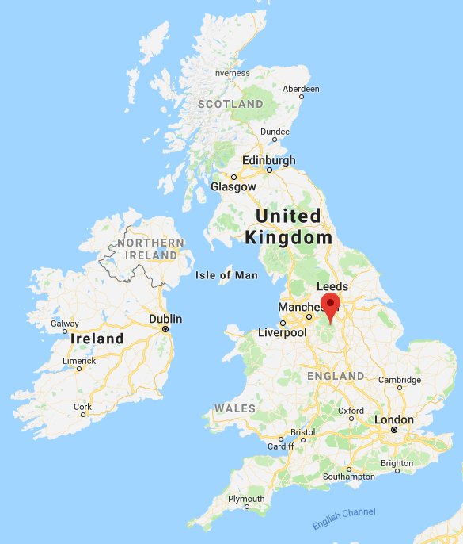
Eyam

Slide 4
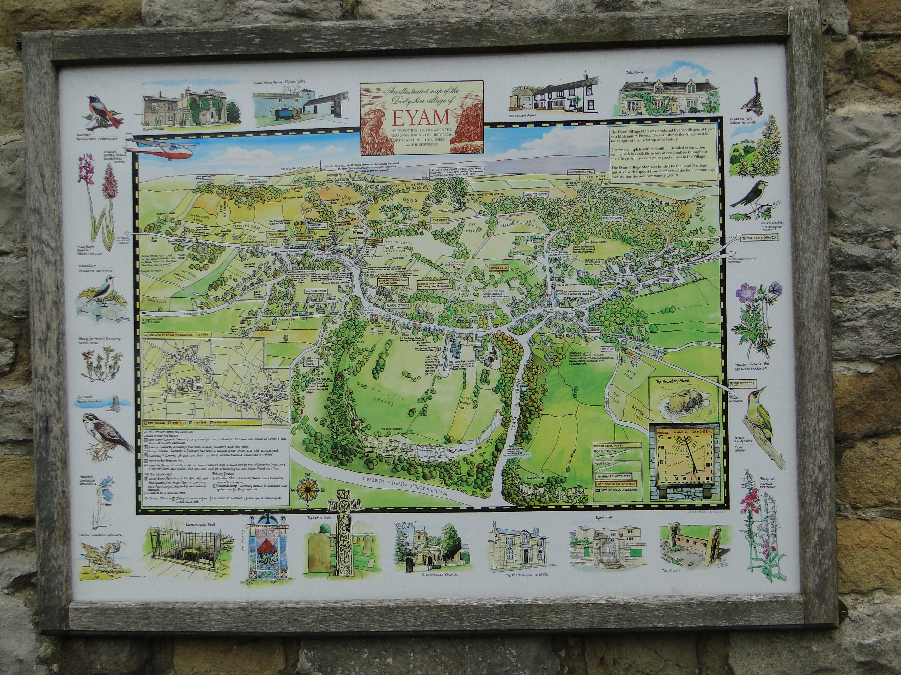
Eyam has forevermore been known as the PLAGUE VILLAGE.

Slide 5
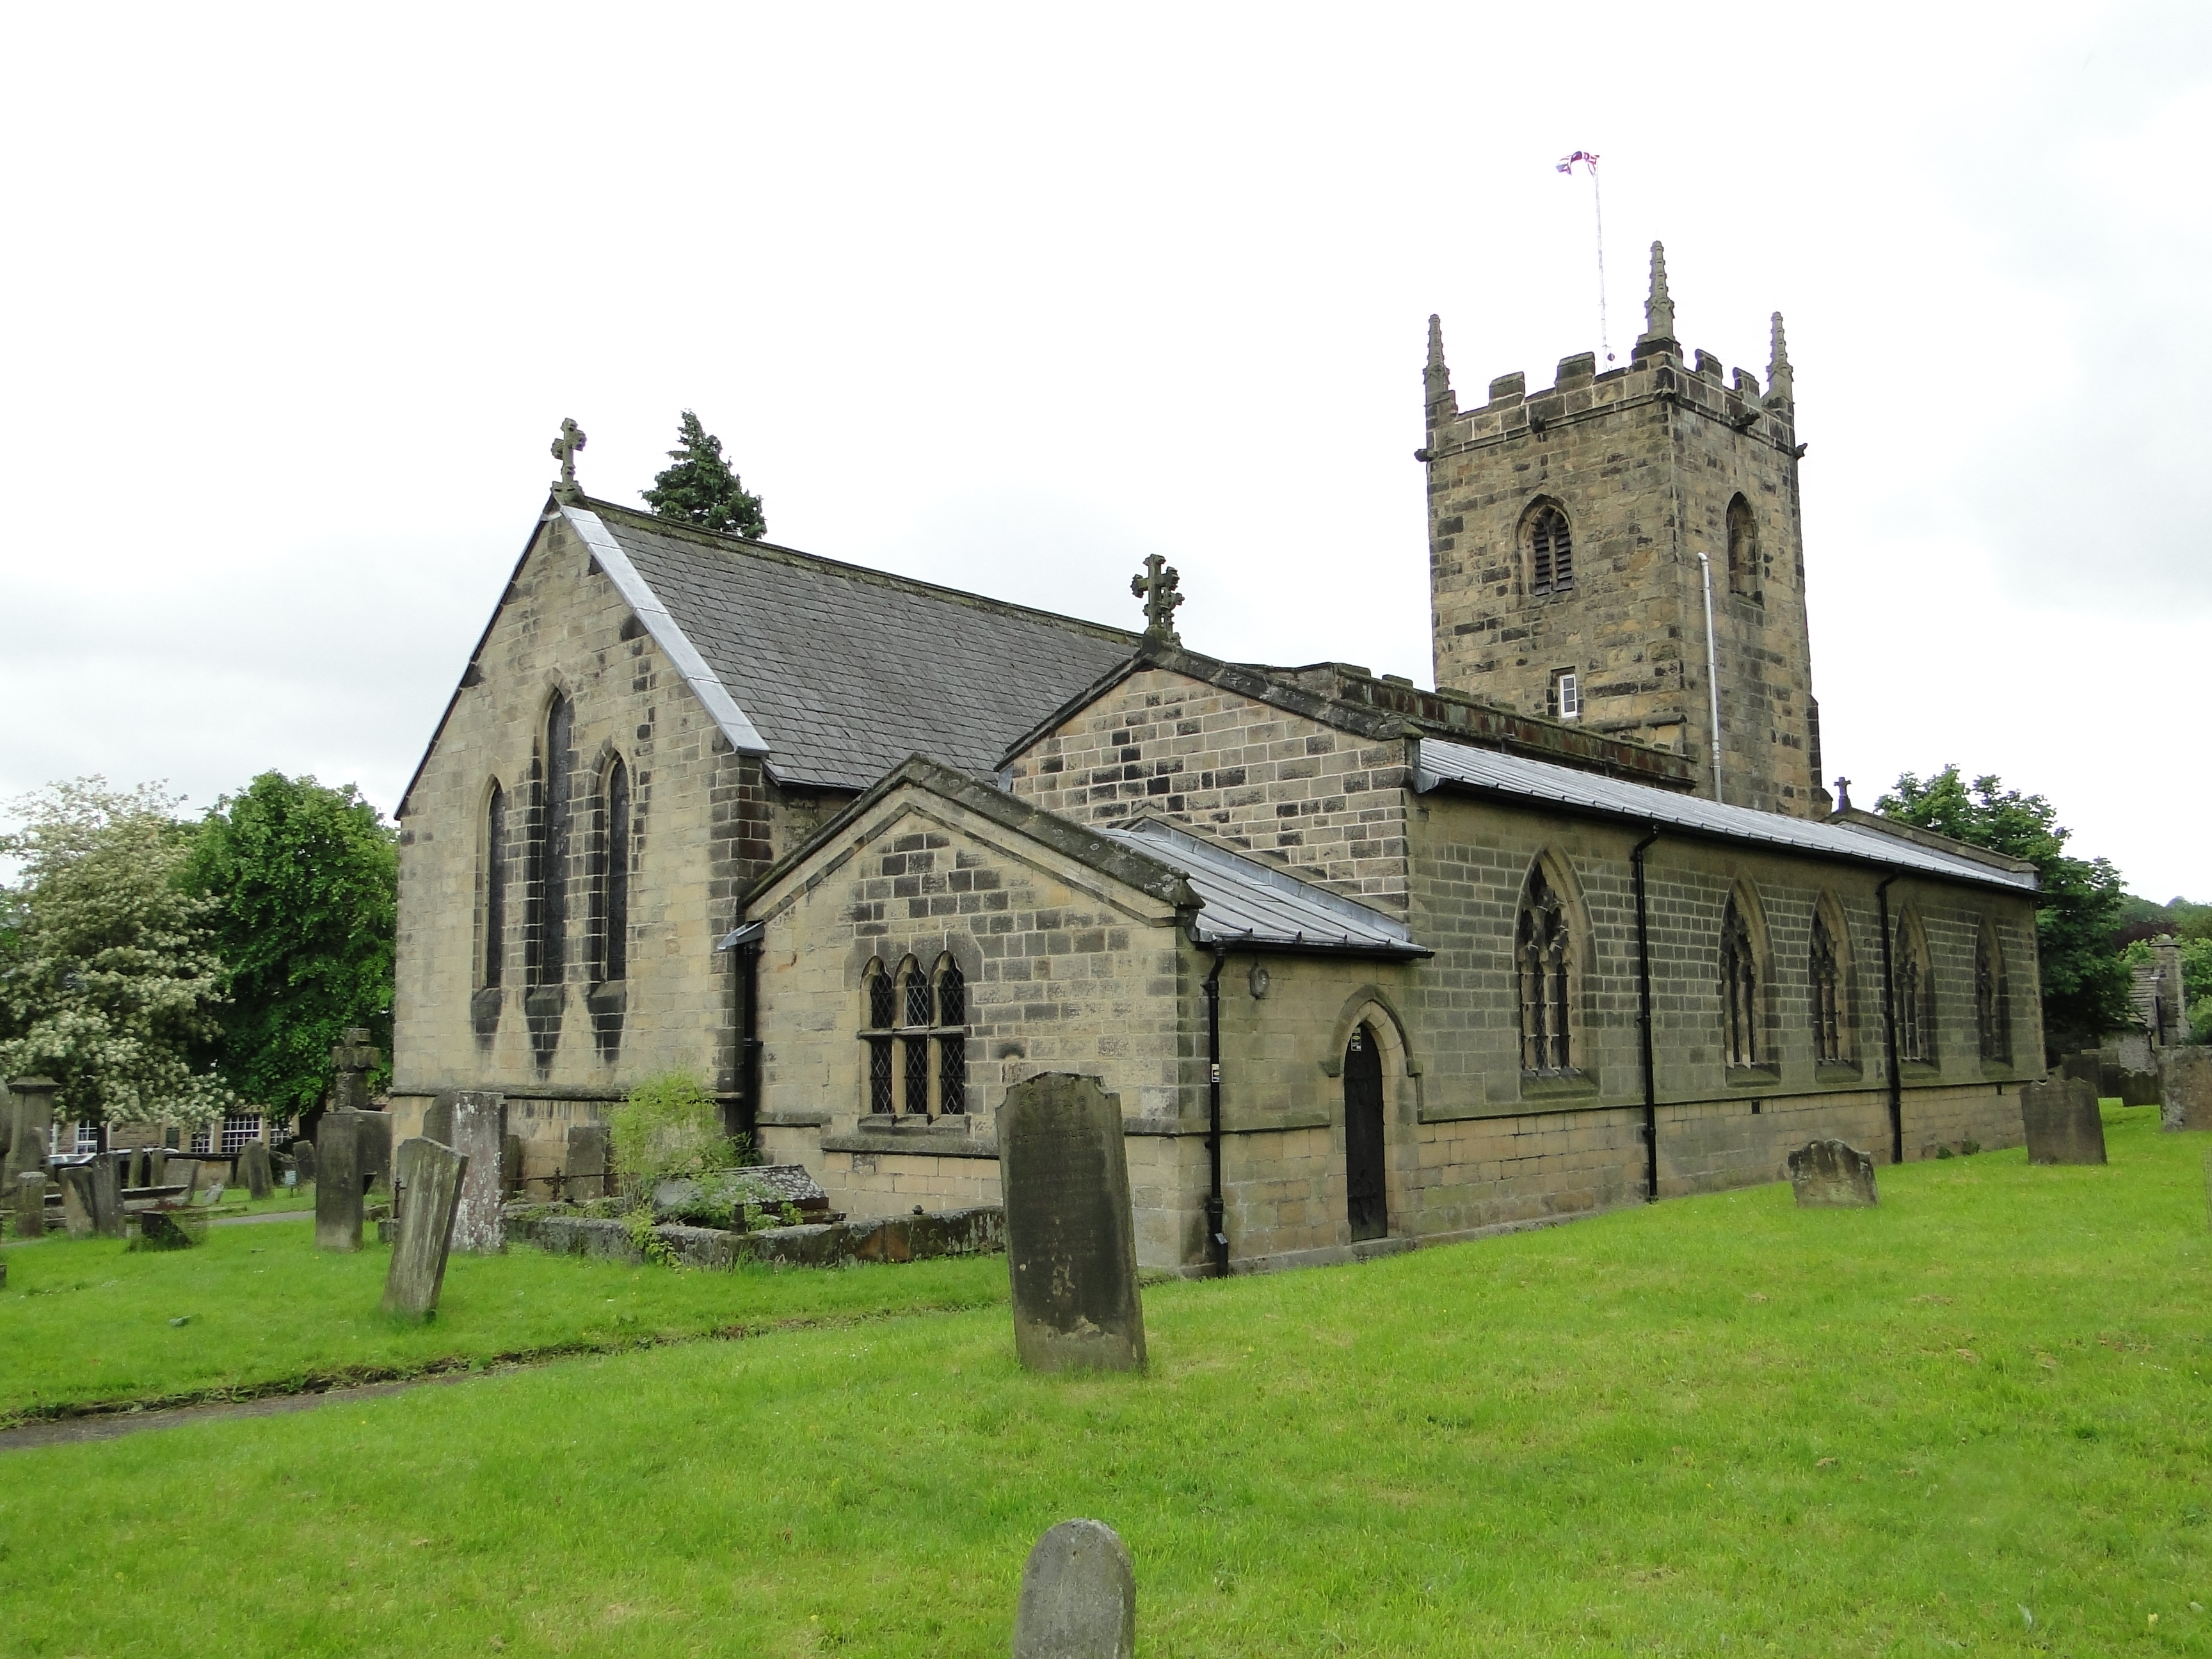
Eyam’s church and churchyard

Slide 6
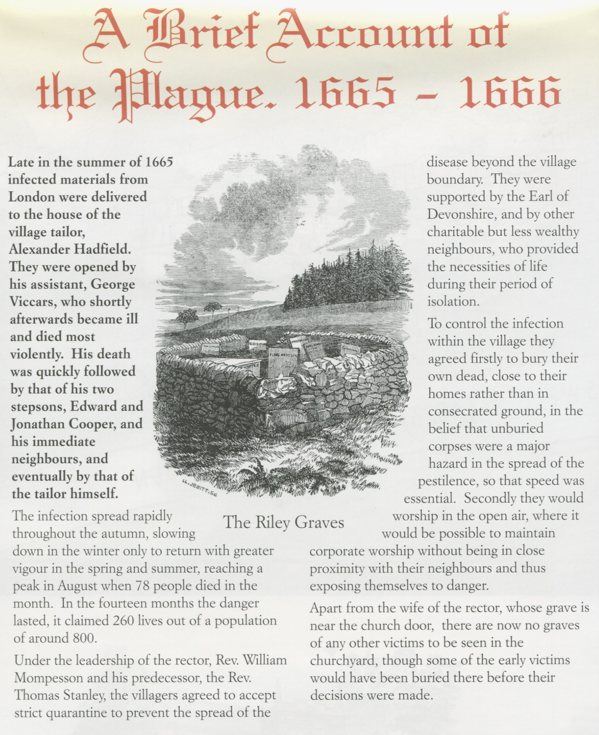

Slide 7
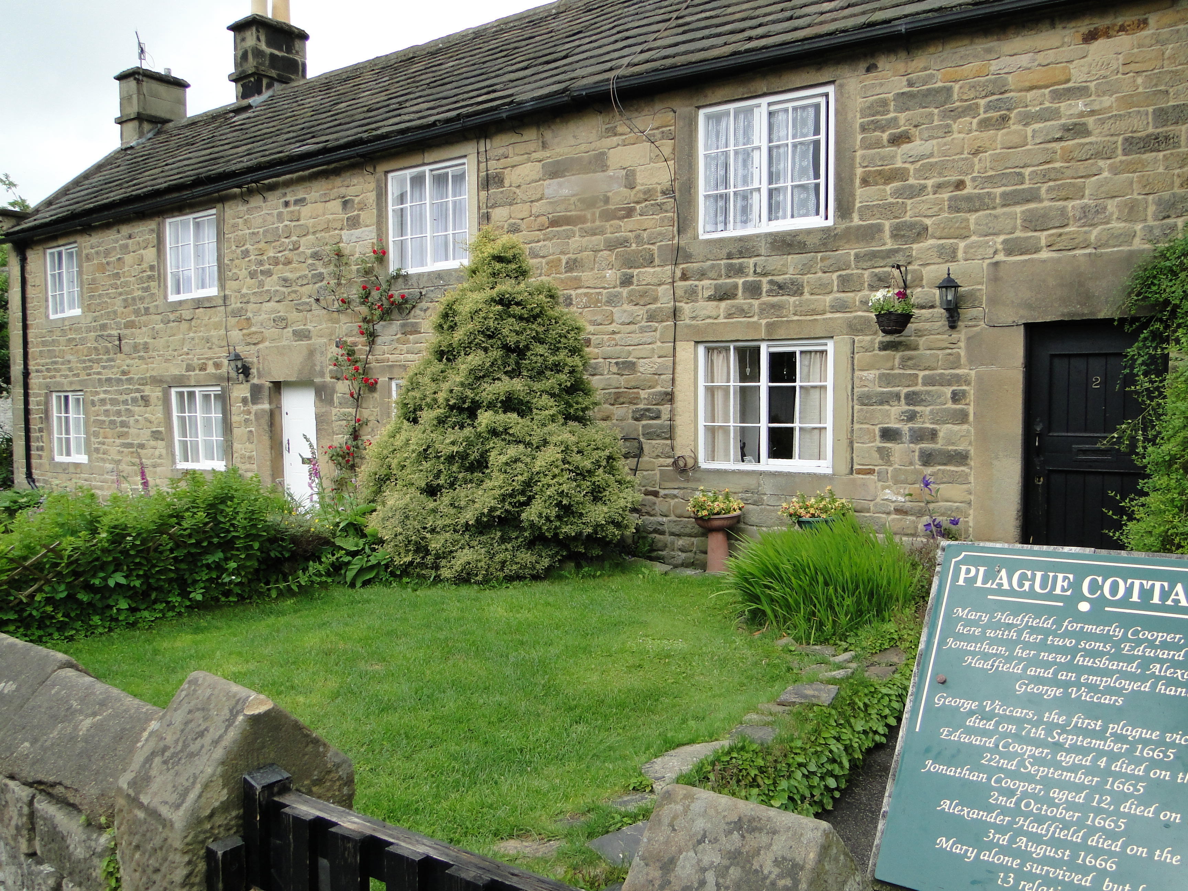

Slide 8
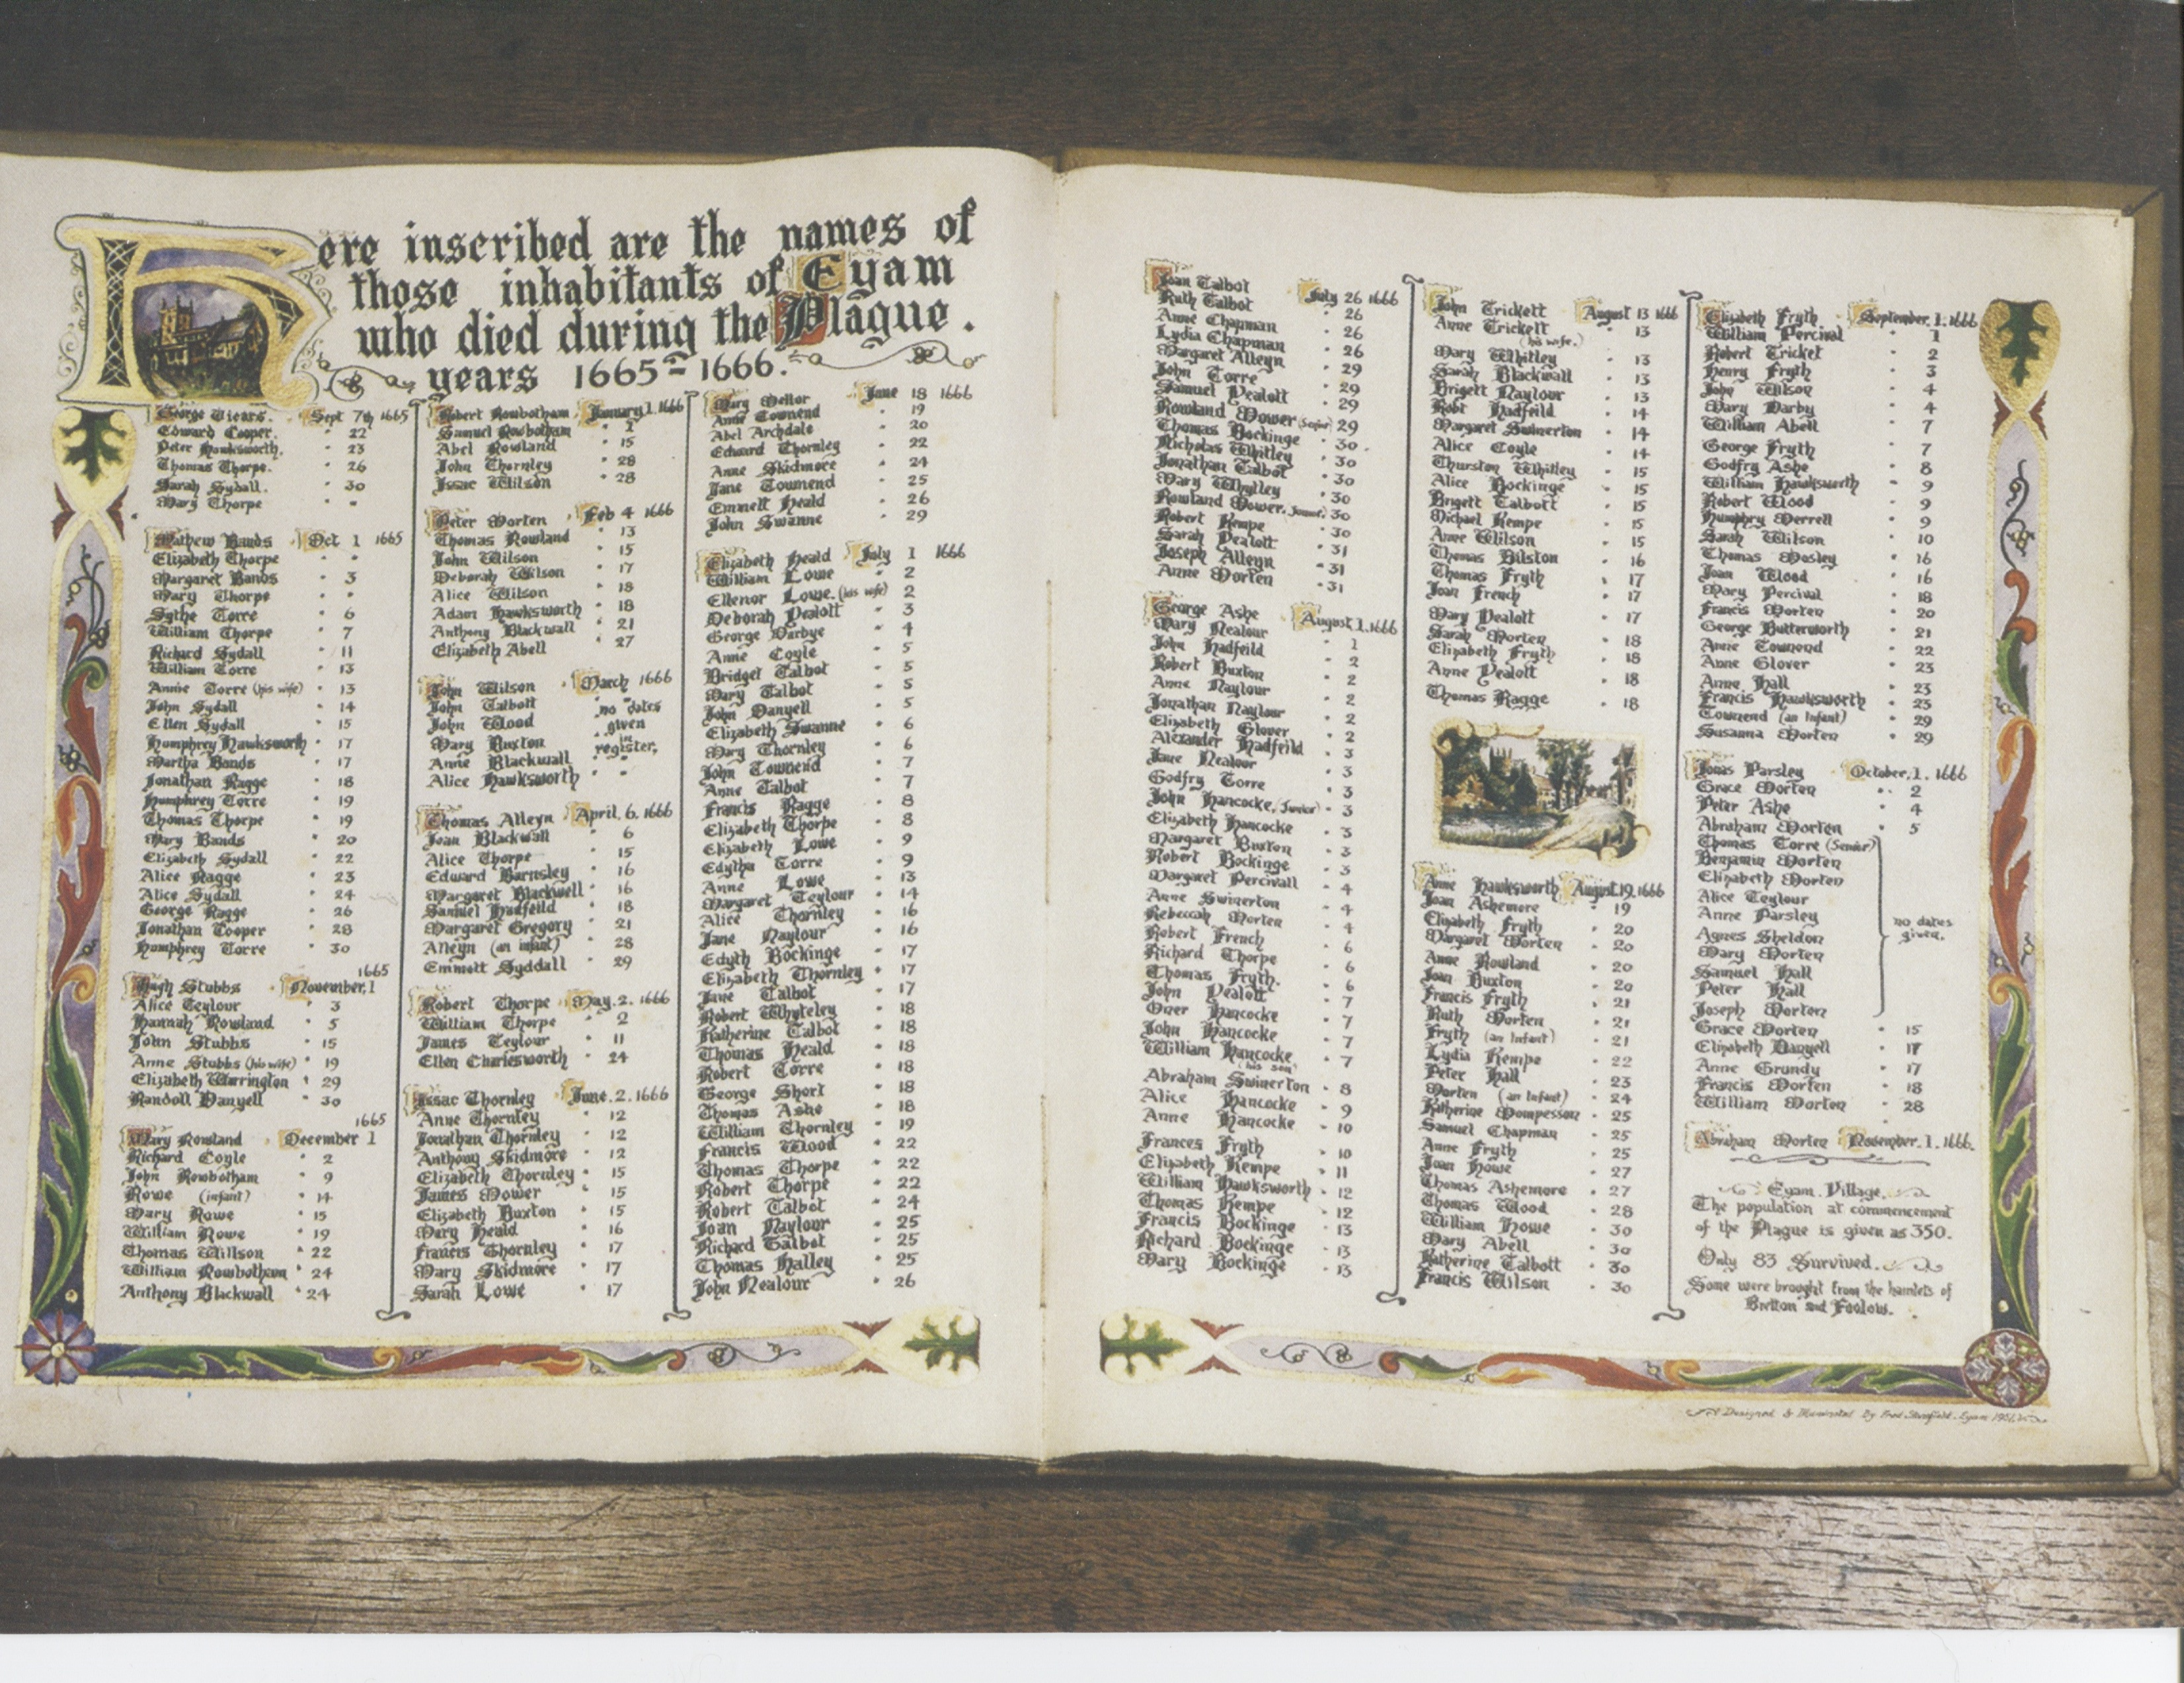
Eyam church record of the plague victims, 1665-1666

Slide 9
The story of Eyam is told in
fictional form in this celebrated 2002 novel.
Brooks gives the reader a deeply
emotional insight into the fear
a society has in the face of an
aggressively expanding, undiscriminating killer disease.
Yet the story gives one hope that
if a society decides to act for the
larger public good through self-sacrifice and cooperation (or, actually, in our current American case, basic decency through tolerance for inconvenience) then our impending year of physical and social constraints can be a year of wonders, too.

