Slide 1
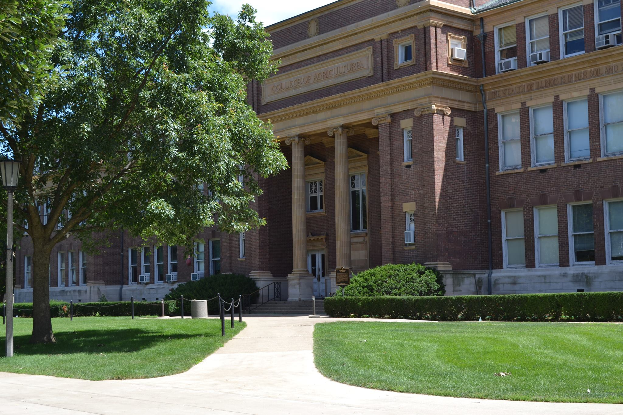
Department of Anthropology
University of Illinois at Urbana-Champaign
Fall 2020 Meet and Greet

Slide 2
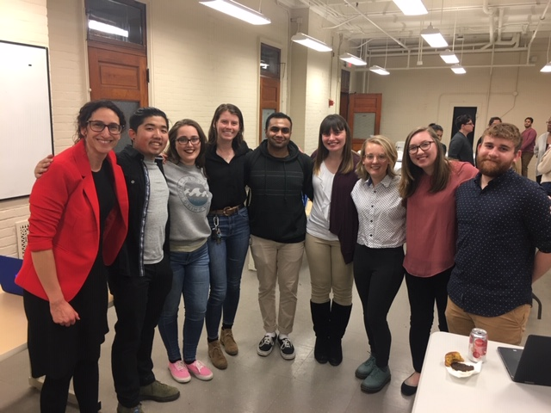
Pre-COVID Anthropology Events [Remember When?]
Anthropology Senior Research Celebration 2019

Slide 3
Pre-COVID Anthropology Events! [Remember When?]
UIUC students at in Lima with Professor Helaine Silverman and undergraduate advisor Dr. Maritza Quinones-Rivera

Slide 4
Department Leadership Team
Kate clancy
Ripan S. Malhi
Maritza Quiñones
New director of graduate studies
Director of undergraduate studies
Undergraduate advisor

Slide 5
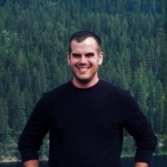
Thanks to Our Amazing Office Staff
Karla Harmon
Joyce Dowell
Zach Langheim
Office manager and assistant to the head
Graduate secretary
Financial and Accounting Officer

Slide 6
Welcome to our new graduate students
Margaret Giacalone
Advisors Andy Orta, Jenny Davis
Melissa Hendrien
Advisor Jeffrey Martin
Dan Matis
Advisor Laura Shackelford
Navashni Naidoo
Advisor Stan Ambrose
Adam Tufano
Advisor Tim Pauketat
Sahara Vilchis
Advisor: Ripan Malhi
Yifan Wang
Stan Ambrose, Lisa Lucero

Slide 7
Welcome to our new faculty
Katelyn bishop
Brandon ritchison
Assistant professor
Assistant professor

Slide 8
Welcome to our
NAGPRA Program Officer
Dr. Krystiana Krupa
PhD Anthropology

Slide 9
Congratulations to Newly Promoted Faculty
Jenny davis
Jeff martin
Cris hughes
Associate professor
Associate professor
Clinical associate professor

Slide 10
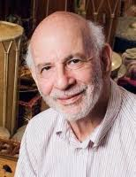
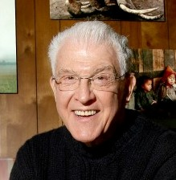
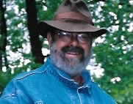
In Memorium
Clark E. Cunningham 1934-2020
Bruno Nettl 1930-2020
Edward M. Bruner – 1924- 2020
Charles M. Keller 1936-2020

Slide 11
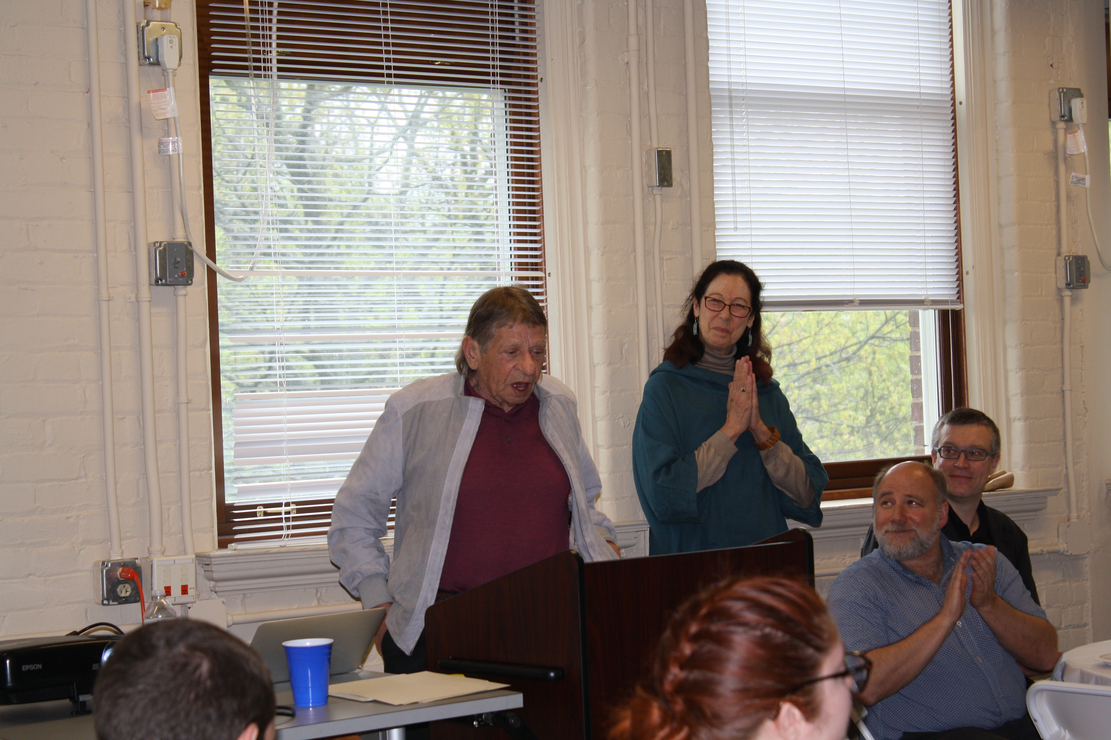
In Memorium
Paul A Liebman 1947- 2020
Spring Banquet 2019

Slide 12
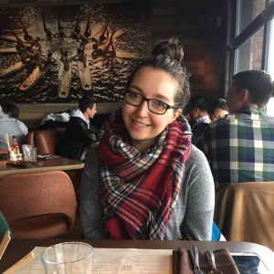
Department Graduate Student Awards
Ben krupp
DEMITRI B. SHIMKIN AWARD
for the most outstanding research paper written by an Anthropology Graduate Student.
Jamie arjona
Caitlyn antoniuk
Merri wilson
EDWARD M. BRUNER AWARD
for Academic Excellence and Promise in Anthropology
FOREST N. BAKER AWARD IN AMERICAN ARCHAEOLOGY
for the best dissertation proposal in archaeology
GEORGE L. BESLOW AWARD –
For Academic excellence - one semester of Funding

Slide 13
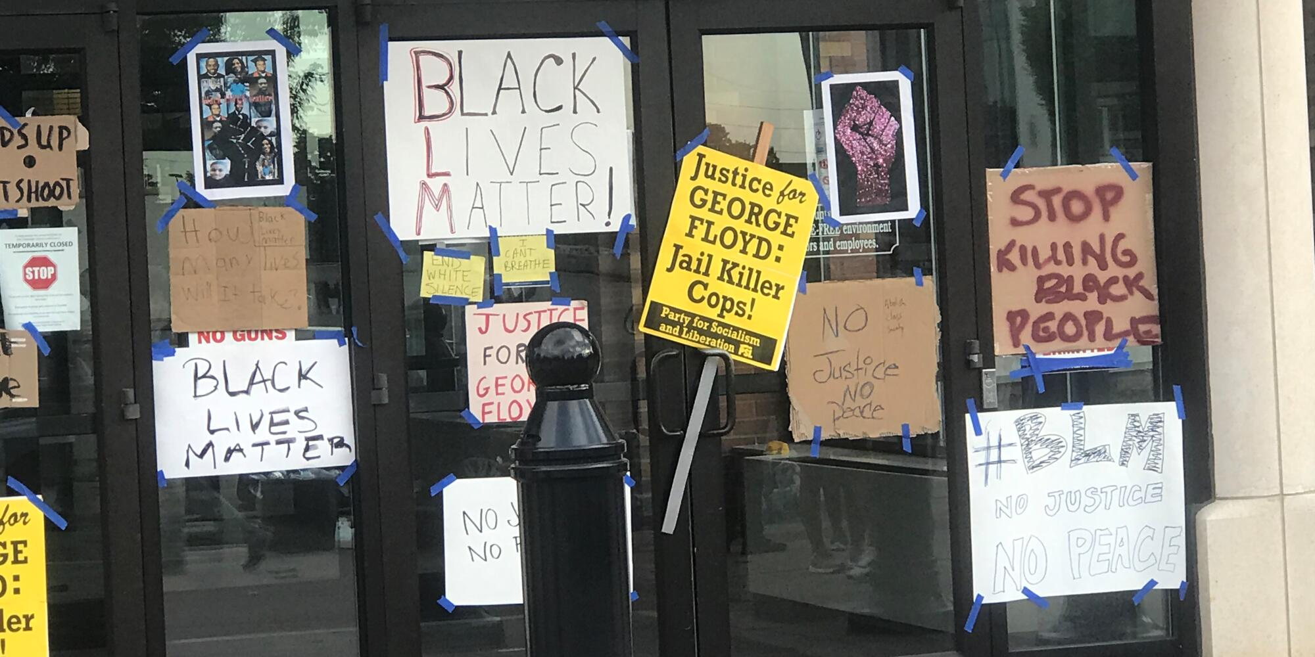
graduate Student awards
Alana Ackerman-– Fulbright-Hays Dissertation Research Grant
Joseph Coyle – Nicholson Graduate Fellowship from Unit for Criticism & Interpretive Theory (summer 2020)
Lila Dodge – Illinois Global Institute FLAS (summer 2020) and IPRH Research Cluster grant AY 20-21
Chibundo Egwuatu – University YMCA Fred S. Bailey Fellowship for Community Leadership and IPRH Research Cluster grant AY 20-21
Brenda Garcia – IPRH Andrew W. Mellon Pre-Doctoral Fellowship in Legal Humanities AY 20-21
Jeongsu Shin – IPRH Fellowship AY 20-21

Slide 14
GRADUATE COLLEGE AWARDS
Dissertation Completion Award 2020
Paul Michael Atienza
Dissertation Travel Award 2019-2020
Fall 2019:
Aimee Carbaugh
Bea Maldonado
Spring 2020:
Alana Ackerman
Grazzia Grimaldi
Conference Travel Award 2019-2020
Maria Fox
Brenda Garcia
[Spring 2020: was cancelled due to Covid-19]

Slide 15
undergraduate student Awards
PATRICIA O’BRIEN AWARD for an outstanding paper in anthropology
Harold Adams
Priya Bhatt (Honorable Mention)

Slide 16
PAUL A. LIEBMAN AWARDS 2020
FOR U/G SUMMER RESEARCH and INTERNSHIPS
Patricia Avent (Internship) Forensic research w/ Dr Hughes; COVID -19 research w Dr Brinkworth
Kaiya Clodfelder (Internship) Forensics Investigation Research Station (FIRS), Colorado Mesa University
Citlali Roman (Internship) Indigenous Language Project w/ Dr Maldonado
Hayat Zarzout (Independent Research) Syrian Refugee Research Project w/Dr Dominguez

Slide 17
ANTHROPOLOGY PhDs 2019-20 = 13!
August 2019:
Alyssa Bader Advisor: Ripan Malhi
Ofira Fuchs Advisor: Virginia Dominguez
Agnes Sohn Advisor: Andy Orta
December 2019:
Abby Asangba Advisor: Rebecca Stumpf
Jeanie Larmon Advisor: Lisa Lucero
Amanda Lee Advisor: Lye Konigsberg
Allie Zachwieja Advisor: Laura Shackelford
May 2020:
Maria Fox Advisor: John Polk
Matthew Go Advisor: Lyle Konigsberg
Ezgi Guner Jessica Greenberg
Julie Torres Advisor: Alejandro Lugo
August 2020:
Erin Benson Advisor: Tim Pauketat
Katie Lee Advisor: Kate Clancy
Congratulations!

Slide 18
LIST OF TEACHERS RANKED EXCELLENT BY THEIR STUDENTS
SPRING 2019
Jenny DAVIS 471, 499
Susan FRANKENBERG 462
Chris HUGHES,247
Elise KRAMER 270
Ellen MOODIE 414
Mary ROGERS 249
Laura SHACKELFORD 399,499
Helaine SILVERMAN 175
Emma VERSTRAETE 379
TAs
Claire BRANIGAN 271
Joseph COYLE 230
Mary WILSON 240
FALL 2019
Kate CLANCY 399, 438
Chris FENNELL 220
Petra JELINEK 399,498
Elise KRAMER 104,372
Andy ORTA 423
Laura SHACKELFORD 399
Helaine SILVERMAN 460
Karshik YARLAGADDA 441
TA’s
Caitlyn ANTONIUK 220
Brenda GARCIA 104
Valerie SGHEIZA 347
Grace SHAW 143
Negin VALIZADEGAN 143
SPRING 2020
Katelyn BISHOP 499
Jessica BRINKWORTH 240
Kate CLANCY 110
Jenny DAVIS 374
Jessica GREENBERG 488
Cris HUGHES 346
Petra JELINEK 243
Andy ORTA 515
Brandon RITCHISON 449
TA’s
Rachel RUSEN 240
Ananya SHRESTHA 271

Slide 19
Some Recent Faculty Awards, Grants, News
Chris Fennell
2020 Daniel G. Roberts Award for Excellence in Public Historical Archaeology for “commitment to public scholarship” and “anti-racism scholarship and education in historical archaeology,” awarded by the Society for Historical Archaeology
Served as President elect and then President of the Illinois Archaeological Survey in 2018-2019
Jenny Davis
OVCRI Faculty Fellow of Indigenous Research and Ethics
New Director of American Indian Studies
Kate Clancy
Recognized by National Academies of Science, Engineering and Medicine for service on the Action Collaborative on Preventing Sexual Harassment in Higher Education
Campus Distinguished Award for Excellence in Public Engagement Award

Slide 20
Some Recent Faculty Awards, Grants, News
Gilberto Rosas
LAS Conrad Humanities Scholar Award 2020 -25.
Lisa Lucero
National Science Foundation Grant for 3yrs research on “Diverse and Sustainable Resource Management among the Rural Maya: Salvage Archaeology in Central Belize’
2 Publications w/ Graduate students Jess Gonzalez and Jeannie Larmon
Korinta Maldonado
J. Frederick Miller Award for Distinguished Service by a University of Illinois Faculty (for promotion of language justice; building bridges between local Maya communities, school district and local service providers)

Slide 21
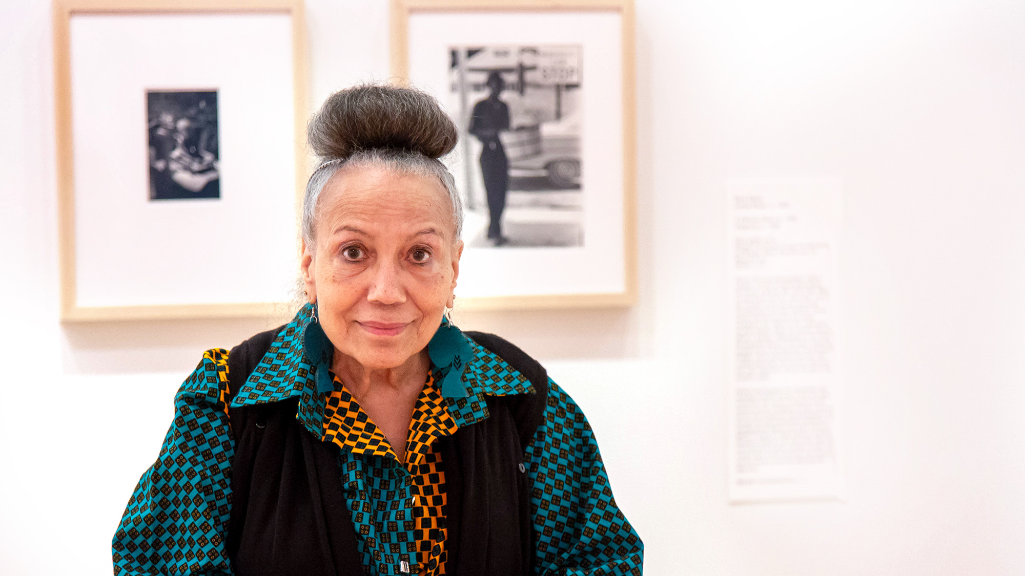
New Gift Fund
The Doris A. Derby Anthropology Scholarship
Dr. Doris A. Derby
activist, photographer, artist, professor and 2016 Alumni Achievement Award recipient.
Thanks to our distinguished alumnus, Dr. Derby who has generously established a scholarship to “support students enrolled in the Department of Anthropology who are pursuing research related to the presence, history,
culture, and/or status of the African American Community”

Slide 22
ANTHROPOLOGY DISTINGUISHED SERVICE AWARD
This award is given by the head to a particular individual for their distinguished service through a commitment to teamwork and leadership and dedication.
In recognition of her outstanding service as Director of Graduate Studies, and an inspiration and excellent mentor to our graduates, this year’s award goes to
LAURA SHACKELFORD

Slide 23
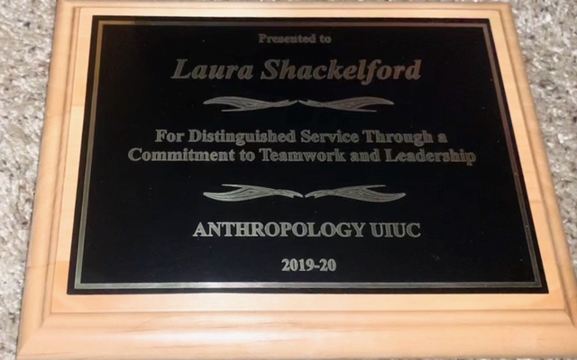
Congratulations Laura!

Slide 24
ANTHROPOLOGY DISTINGUISHED SERVICE AWARD
***30 Years***
CONGRATULATIONS and THANKS
to Karla Harmon
With deep appreciation for your dedication to the efficient management of the Anthropology Department

